Slide 1
CASE STUDY ASSIGNMENT-2
Group Members:
UID 18BCS6074 (Group Leader)
UID 18BCS6076
UID 18BCS6081
UID 18BCS6101

Slide 2
ABSTRACT
There is a consumer finance company which specializes in lending various types of loans to urban customers. When the company receives a loan application, the company has to make a decision for loan approval based on the applicant’s profile.
When a person applies for a loan, the company has to decide whether to accept or reject the applicant for lending loan.
We have to analyze previous data to understand the attributes of customers to which the company should lend the loan so that the company faces minimum loss.

Slide 3
Problem Solving Methodology
IMPORTING THE DATA FROM CSV FILE
DATA UNDERSTANDING
DATA CLEANING
DATA ANALYSIS

Slide 4
UNIVARIATE ANALYSIS
BIVARIATE ANALYSIS
ANALYSING THE DRIVER VARIABLES

Slide 5
CHECKPOINT 1 (DATA cleaning)
Data cleansing or data cleaning is the process of detecting and correcting (or removing) corrupt or inaccurate records from a record set, table, or database.
Eliminating the missing value( NaN ) from the imported data set in order to reduce inconsistency.
What we did here:
We analyze and consider those attributes which appears useful , like ‘time’ , ‘interest rate’ etc. and convert the given data types of these attributes to ‘integer’ data type so that it can be used in the analysis.

Slide 6
Checkpoint 2 (DATA ANALYSIS)
The objective is to identify predictors of default so that at the time of loan application, we can use those variables for approval/rejection of the loan.
Now, there are broadly 3 types of variables -
1. those which are related to the applicant (demographic variables such as age, occupation, employment details etc.)
2. loan characteristics (amount of loan, interest rate, purpose of loan etc).
3. Customer behavior variables (those which are generated after the loan is approved such as delinquent 2 years, revolving balance, next payment date etc.).

Slide 7

There can be three varieties of customers:
Fully Paid
Current
Charged off
As we have nothing to do with the ‘current’ and ‘Fully Paid’ type of customer for our analysis so we will not consider them.
We will only analyze with the charged off type of customer.

Slide 8
Checkpoint 3 (UIVARIATE analysis)
Univariate analysis is the simplest form of analyzing data. “Uni” means “one”, so in other words your data has only one variable. It doesn’t deal with causes or relationships (unlike regression) and it’s major purpose is to describe; it takes data, summarizes that data and finds patterns in the data.

Slide 9
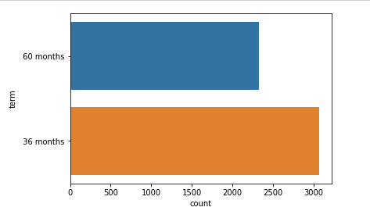
Factor : term
36 months loan are observed to have more number of defaulters than 60 months loans.

Slide 10
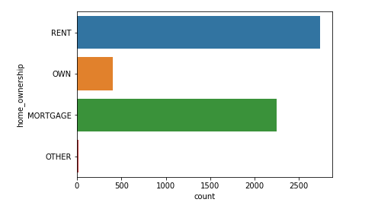
HOMEOWNERSHIP
Rented house has the maximum number of defaulters

Slide 11
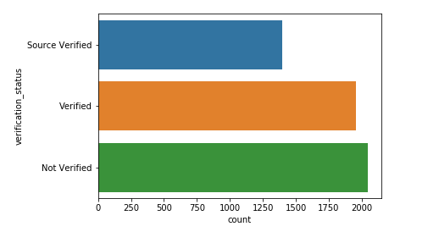
VERIFICATION STATUS
Not- verified status has the maximum number of defaulters

Slide 12
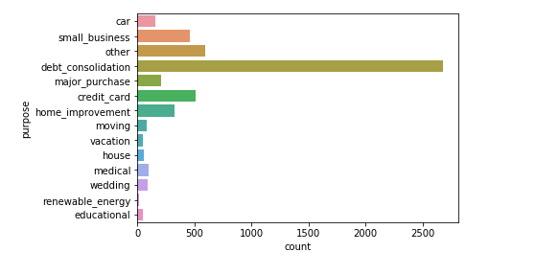
PURPOSE
‘debt consolidation’ , ‘Small business’ ,’Credit card’ , ’Home improvement’
Has the maximum number of defaulters

Slide 13
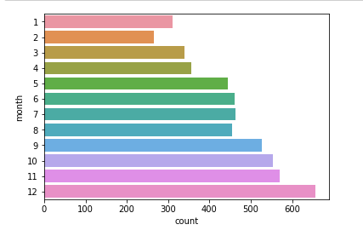
MONTH
December has the maximum number of defaulters

Slide 14
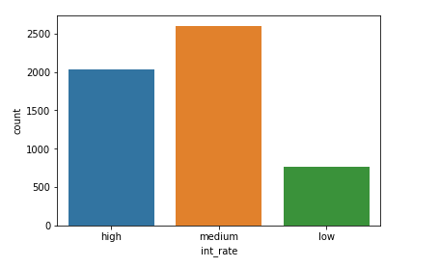
INTEREST RATE
Customers having higher interest rate on their loans are the maximum defaulters

Slide 15
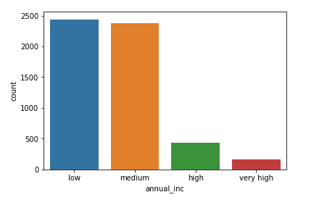
ANNUAL INCOME
Customers having lower income are the maximum defaulters

Slide 16
Results ( analysis OF DRIVER VARRIABLES)
Term: 36 months
House ownership: Rented house
Verification status: Verified loans
Purpose: debt consolidation
Small business
Credit card
Home improvement
5. Month: December
Interest rate: Higher Interest rate
Annual Income: Lower Annual Income
These are the driving factors which are the main factors that can be removed to minimize defaulters and prevent the company from losses.

Slide 17
THANK YOU

